Slide 1
Heterogeneous Memory Management
Neha Agarwal
December 18, 2015
Thesis Proposal

Slide 2
Conventional Memory Hierarchy
CPU
GPU
Memory (DDR)
Memory (GDDR)

Slide 3
Heterogeneous Memory Systems
↑ Bandwidth
CPU
GPU
Memory
(DDR)
Memory
(GDDR)
↓ Latency
Different Coherence Domain
Memory
(XPoint)
Memory
(DDR)
↓ Cost per bit

Slide 4
Core
Memory
Optimized for latency

Slide 5
Wait, but...
What about bandwidth to my GPU?
Core
Memory
Optimized for latency
What about cost/bit in my data-center?

Slide 6
My Thesis
Bandwidth
Coherence Domain
Costs/bit
Memory management accounting differences in memory technologies
Application transparent
Dynamic decisions at runtime
Equips OS/Programmer

Slide 7
My Contributions
BW-AWARE placement for bandwidth maximization in GPUs, +35% over Linux Interleave placement
Dynamic page migration for GPU with range expansion and bandwidth balancing, +6% over Legacy CUDA
Selective Caching for CC-NUMA CPU-GPU systems to simply coherence, 93% of hardware cache-coherent system

Slide 8
Proposal: Thermostat
Huge page aware, application transparent data placement in 2-tiered memory system

Slide 9
Talk Outline
Bandwidth maximization in GPUs
Eliminating CPU-GPU Cache Coherence
Proposal: Thermostat

Slide 10
Bandwidth Maximization in GPUs
Agarwal, N., Nellans, D., O'Connor, M., Keckler, S. W., & Wenisch, T. F. (2015, February). Unlocking bandwidth for GPUs in CC-NUMA systems. In High Performance Computer Architecture (HPCA), 2015 IEEE 21st International Symposium on (pp. 354-365).
Agarwal, N., Nellans, D., Stephenson, M., O'Connor, M., & Keckler, S. W. (2015, March). Page Placement Strategies for GPUs within Heterogeneous Memory Systems. In Proceedings of the Twentieth International Conference on Architectural Support for Programming Languages and Operating Systems (pp. 607-618).

Slide 11
GPU Workloads: Memory Bandwidth Sensitive
Applications perform up to 2.8x better with 3x more BW
Notes:
In order to understand why utilizing CC-BW is crucial to the GPU performance, let us look at the sensitivity of GPU applications to the memory BW.
Explain the graph
Hence it is imperative to exploit as much BW as possible in order to get the best possible performance for most of the GPU workloads.

Slide 12
GPU Workloads: Memory Latency Tolerant
Applications are more sensitive to memory bandwidth than latency
Notes:
However, we observed that most of these workloads are tolerant to memory latency.
Explain the graph
All except one are tolerant to memory latency
Hence, we can see that memory bandwidth is a better dictator of GPU application performance than main memory latency. Hence it is important to exploit the BW available through CC-interconnect to maximize performance although those memory access will have higher latencies.

Slide 13
Evolving GPU Memory System
NVLink
(Cache Coherent)
GDDR5
GPU
PCI-E
CPU
DDR4
80 GB/s
200 GB/s
15.8 GB/s
80 GB/s
CUDA 1.0-5.x
CUDA 6.0+: Current
Future
Roadmap
cudaMemcpy
Programmer controlled copying to GPU memory
Unified virtual memory
Run-time controlled copying →
Better productivity
CPU-GPU cache-coherent
high BW interconnect
How to best exploit full BW while maintaining programmability?
Notes:
Let me first take you through the evolution of GPU memory system via a roadmap.
A typical CPU-GPU system today is connected by a PCI-E link. The GPU is connected to high bandwidth GDDR memory and CPU is connected to high-capacity but lower-bandwidth DDR memory.
Example system
In the legacy systems from first generation of CUDA uptill CUDA 5, programming model was such that GPU could only access the GDDR memory attached to it. Programmer was responsible to identify the data accessed by the GPU and manually transfer it to the GDDR memory using cudaMemcpy calls. Such a programming model demands high effort on part of the programmer.
Moving forward CUDA 6.0 onwards Unified virtual memory was introduced, wherein the programmer is no longer required to make explicit data copies. Using the same hardware as in the legacy systems runtime software performs on-demand data copying to the GPU memory. Although this memory abstraction had a significant impact on improving programmer productivity still on-demand copying slows down the running program.
Moving further ahead, we anticipate that CPU & GPU will become cache coherent. As announced by the GPU vendors CPU & GPU will be connected via a high BW interconnect such as NVIDIA’s NVLink. For the first time GPU will be able to transparently access the CPU memory. This future system provides various opportunities for performance enhancement as GPU can now use BW from both CPU and GPU memories. The big question here is how to exploit the full system BW in the best possible way without burdening the programmer to worry about the data placement or copying decisions.
Goals:
Simple programming model
Exploit full DDR + GDDR BW

Slide 14

GPU Bandwidth Utilization
Total System Memory BW
280
GPU
NVLink
CPU
80 GB/s
200
GPU Memory BW
Total Bandwidth (GB/s)
200 GB/s
80 GB/s
80
Additional BW from CC
GDDR5
DDR4
0
100
% of Migrated Pages to GPU Memory
Coherence-based accesses, wastes GPU memory BW
Notes:
Now, let us look at the BW utilization as we start running an application on this system. On the left we will see how GPU accesses the data from the memory system and on the right we will see the BW utilization for those accesses.
For the sake of the programmability, all the data is allocated in the CPU memory to begin with. GPU can access this data from the CPU memory via cache coherence. Hence, the best BW utilization in such topology can be only 80GB/s, which is only 30% of the total system BW. We are not able to use 70% of the system BW which a a big lose from performance perspective.
With no page migrations this system will end up wasting high BW GPU memory.
Next, we move onto the future CC-NUMA system where CPU and GPU are connected through a high BW interconnect of 80GB/s. For the sake of programmability all the data structures reside in the CPU memory to start with. GPU can do coherence-based accesses and thus the total BW utilizes in this system will be 80GB/s. Clearly, with no page migration enabled from DDR to GDDR memory this system will end up wasting high BW GPU memory.

Slide 15
GPU Bandwidth Utilization
Total System Memory BW
280
GPU
NVLink
CPU
80 GB/s
200
GPU Memory BW
Total Bandwidth (GB/s)
200 GB/s
80 GB/s
80
Additional BW from CC
GDDR5
DDR4
70
0
100
% of Migrated Pages to GPU Memory
Bandwidth-Aware Placement
Place data in the ratio of memory bandwidths
Notes:
Remember, our goal here is to reach the peak BW as soon as possible. As pages are migrated to the GPU memory BW utilization will go up. We have observed that the best bandwidth utilization happens when the application data is spread across the GDDR and DDR memories in the ratio of their bandwidths. In our ASPLOS 2015 paper we will discuss more about the static placement policies. The goal of this work however is to dynamically migrate pages so that data is divided in the ratio of memory BW and thus GPU can concurrently access both the memories.
Distinguish ASPLOS from HPCA
Correct animation
How can we utilize both the CPU and the GPU memory BW? In our ASPLOS 2015 paper we will discuss about the static oracle placement that achieves the goal of maximizing BW utilization from both the memories. By placing data in the ratio of memory BW here it being 70:30% GPU can saturate both the memories and thus achieve the cumulative BW of 280GB/s. The goal of this work is to achieve this static oracle performance by dynamically migrating pages among DDR and GDDR memories.

Slide 16
GPU Bandwidth Utilization
Total System Memory BW
280
GPU
NVLink
CPU
80 GB/s
200
GPU Memory BW
Total Bandwidth (GB/s)
200 GB/s
80 GB/s
80
Additional BW from CC
GDDR5
DDR4
70
0
100
% of Migrated Pages to GPU Memory
Excessive data in GDDR leads to under-utilization of DDR BW
Notes:
As more and more migration happen, a point comes where all the data is transferred to the GPU memory. In such a case GPU memory requests can only be served from GDDR memory. Excessive page migration leads to under-utilization of the CPU memory BW. Hence page migration policy should only migrate pages to unlock memory BW of both the DDR and the GDDR memories.
So, the take away from the above discussion is that we want to utilize both 200GB/s from GDDR memory and 80GB/s from DDR memory at the same time we do not programmer to worry about these decisions.
Let us try to understand how BW is utilized in the Legacy/Current CPU-GPU systems where either programmer/SW runtime copies data accessed by the GPU to the GDDR memory.
On the left we can see a GPU attached to the CPU through low BW PCI-E link. Any data accessed by the GPU has to be placed in the GDDR memory as this system is not CC, which means that DDR BW will not be used by the GPU. All the GPU accesses happen through 200GB/s attached memory. Therefore, the total BW utilization of this topology can be 200GB/s.

Slide 17
BW Maximization Policies
BW-AWARE Placement
Place pages in the ratio of memory bandwidths
Application agnostic policy
Dynamic Page Migration
Aggressively migrate pages upon First-Touch to GDDR memory
Pre-fetch neighbors of touched pages to reduce TLB shootdowns
Throttle page migrations when nearing peak BW
Notes:
In this work, we have developed intelligent dynamic page migration policies that demands no programmer involvement. We aggressively migrate pages to the GDDR memory after a page has been accessed. We employ a technique to pre-fetch neighbors of already accessed pages to reduce TLB shootdowns. Finally, we throttle page migrations when BW utilization peaks as more migration lead to under-utilization of the CPU memory BW.
Our dynamic page migration policy performs 1.95 times better than no migration case, is within 28% of the static oracle performance and is 6% better than the Legacy CUDA.

Slide 18
Simulation Environment
Simulator: GPGPU-Sim 3.x
Heterogeneous 2-level memory
GDDR5 (200GB/s, 8-channels)
DDR4 (80GB/s, 4-channels)
GPU-CPU interconnect
Latency: 100 GPU core cycles
Workloads:
Rodinia applications [Che’IISWC2009]
DoE mini apps [Villa’SC2014]
100 clks additional latency
GPU
CPU
80 GB/s
200 GB/s
80 GB/s
GDDR5
DDR4

Slide 19
BW-AWARE Placement Performance
35% better than INTERLEAVE, 18% better than LOCAL
Notes:
Latency sensitive app (sgemm)
Performance degraded

Slide 20
Dynamic Page Migration
Static Oracle
6% better than Legacy CUDA
Notes:
Nevertheless

Slide 21
Eliminating CPU-GPU Cache Coherence
Agarwal, N., Nellans, D., Ebrahimi, E., Wenisch, T. F., Danskin, J., & Keckler, S. W. (2016, March). Selective Caches in GPUs to Eliminate Cache Coherence. To appear in High Performance Computer Architecture (HPCA), 2016 IEEE 22nd International Symposium.

Slide 22
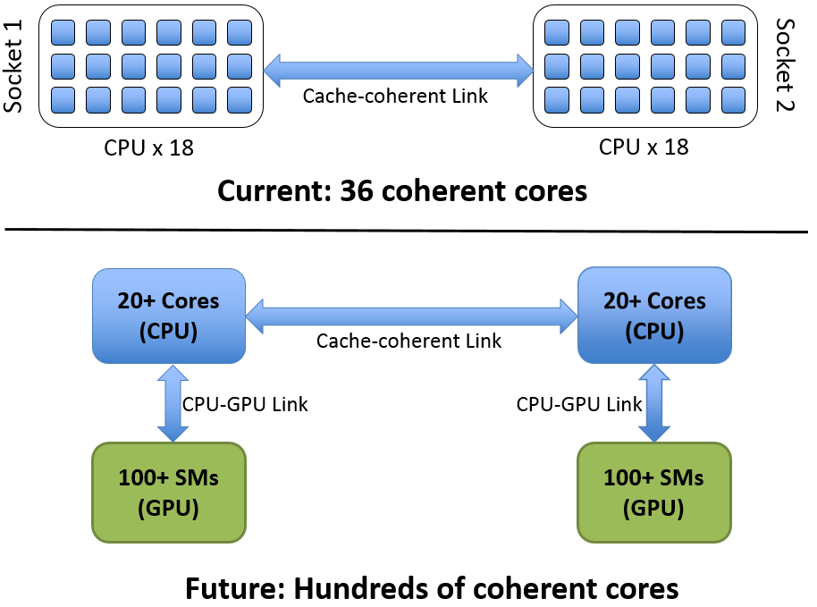
HW Cache Coherence: Liability for CPU-GPU Systems
Goal: Shared virtual address space with performance & programmability
Notes:
Why do we need cache coherence?

Slide 23
Selective GPU Caches
Provides unified shared memory w/o HW cache-coherence
GPU does not cache any data actively used by the CPU
Insensitive to memory access latency
Micro-architectural enhancements to make system performant

Slide 24

Principles Of Selective Caching
CPU caches all memory
GPU never caches CPU-memory
GPU caches GPU-memory if CPU not caching
CPUs
DDR4
DDR4
DDR4
Directory
DDR4
GPU reads DDR:
DIR sends most recent copy
GPU writes DDR:
DIR handles invalidation of CPU caches
CPU reads/writes GDDR:
Line inserted in Remote Directory (Filter) GPU can’t cache lines found in this filter
GDDR5
GDDR5
GDDR5
GDDR5
GDDR5
Remote Directory
GDDR5
GPU
GDDR5
GDDR5
Notes:
Remote Directory Implementation

Slide 25
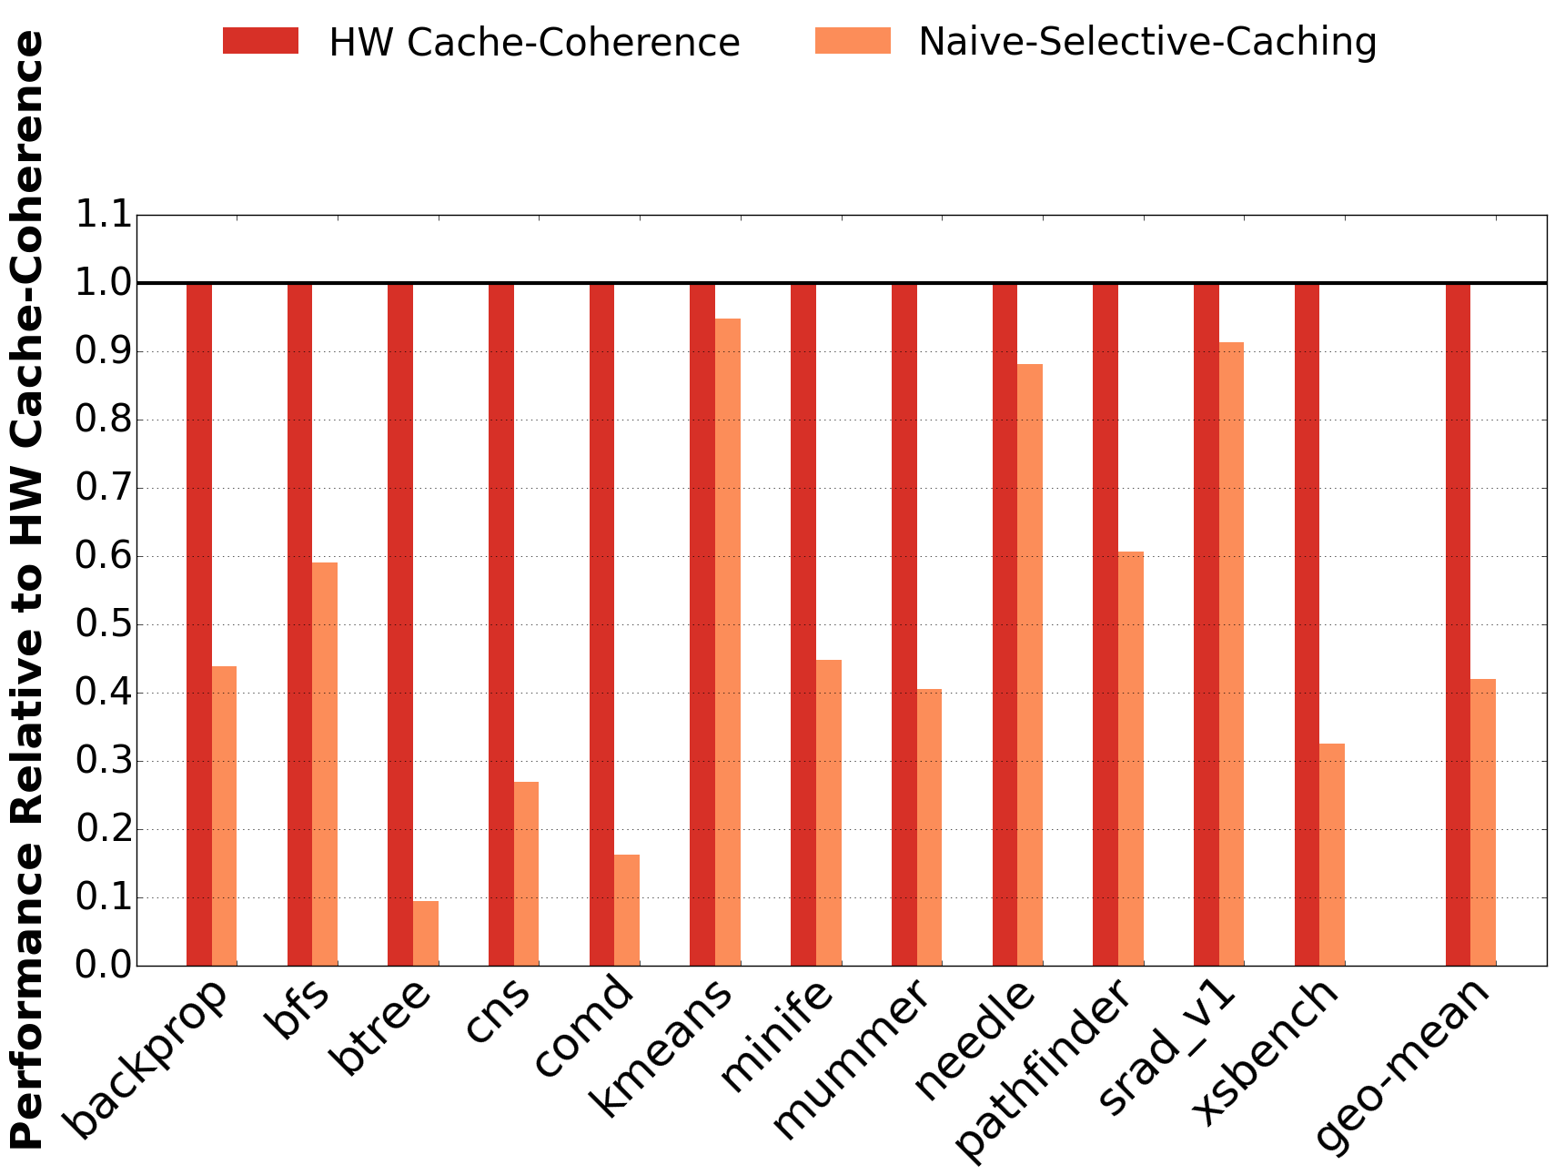
Principles Of Selective Caching
CPU caches all memory
GPU never caches CPU-memory
GPU caches GPU-memory if CPU not caching
CPUs
DDR4
DDR4
DDR4
Directory
DDR4
GPU reads DDR:
DIR sends most recent copy
GPU writes DDR:
DIR handles invalidation of CPU caches
CPU reads/writes GDDR:
Line inserted in Remote Directory (Filter) GPU can’t cache lines found in this filter
GDDR5
GDDR5
GDDR5
GDDR5
GDDR5
Remote Directory
GDDR5
GPU
GDDR5
GDDR5
Notes:
Remote Directory Implementation

Slide 26
Request Coalescing
CPU caches all memory
GPU never caches CPU-memory
GPU caches GPU-memory if CPU not caching
CPUs
DDR4
DDR4
DDR4
Directory
DDR4
CPU/GPU reads DDR:
GPU caches until 1st write to the page
CPU/GPU writes DDR:
Flush read-only pages in GPU caches
and updates page level protection
GDDR5
GDDR5
GDDR5
u
GDDR5
Remote Directory
GDDR5
Request Coalescer
GDDR5
GDDR5
Coalesces GPU requests to DDR
GDDR5
GPU

Slide 27
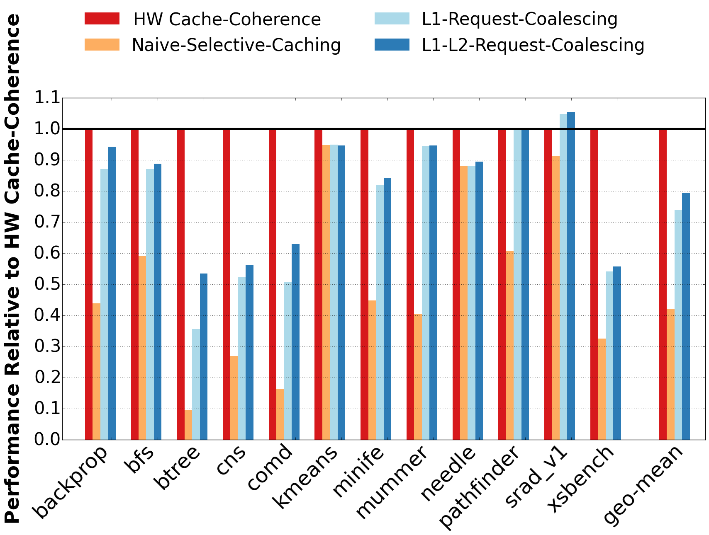
Request Coalescing
CPU caches all memory
GPU never caches CPU-memory
GPU caches GPU-memory if CPU not caching
CPUs
DDR4
DDR4
DDR4
Directory
DDR4
CPU/GPU reads DDR:
GPU caches until 1st write to the page
CPU/GPU writes DDR:
Flush read-only pages in GPU caches
and updates page level protection
GDDR5
GDDR5
GDDR5
u
GDDR5
Remote Directory
GDDR5
Request Coalescer
GDDR5
GDDR5
Coalesces GPU requests to DDR
GDDR5
GPU

Slide 28
CPU-side Client Cache
CPU caches all memory
GPU never caches CPU-memory
GPU caches GPU-memory if CPU not caching
v
Reduces DDR traffic from the GPU
CPUs
DDR4
Client Cache
DDR4
DDR4
Directory
DDR4
CPU/GPU reads DDR:
GPU caches until 1st write to the page
CPU/GPU writes DDR:
Flush read-only pages in GPU caches
and updates page level protection
GDDR5
GDDR5
GDDR5
u
GDDR5
Remote Directory
GDDR5
Request Coalescer
GDDR5
GDDR5
Coalesces GPU requests to DDR
GDDR5
GPU

Slide 29
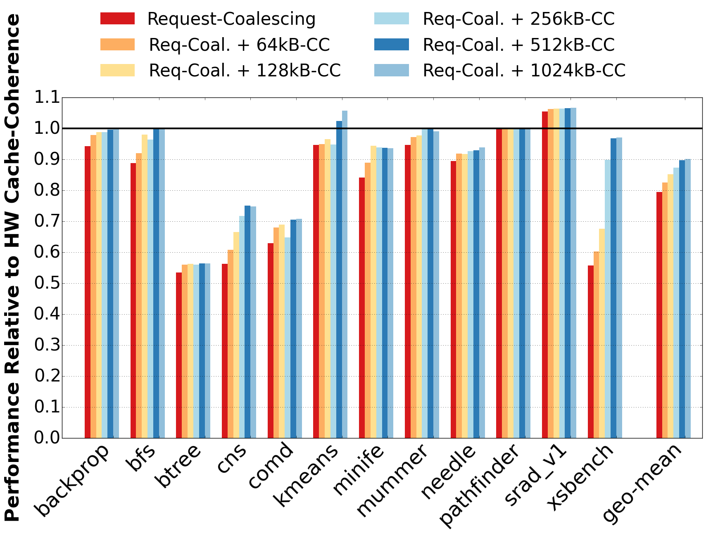
CPU-side Client Cache
CPU caches all memory
GPU never caches CPU-memory
GPU caches GPU-memory if CPU not caching
v
Reduces DDR traffic from the GPU
CPUs
DDR4
Client Cache
DDR4
DDR4
Directory
DDR4
CPU/GPU reads DDR:
GPU caches until 1st write to the page
CPU/GPU writes DDR:
Flush read-only pages in GPU caches
and updates page level protection
GDDR5
GDDR5
GDDR5
u
GDDR5
Remote Directory
GDDR5
Request Coalescer
GDDR5
GDDR5
Coalesces GPU requests to DDR
GDDR5
GPU

Slide 30
Variable Width Request Transfer
CPU caches all memory
GPU never caches CPU-memory
GPU caches GPU-memory if CPU not caching
v
Reduces DDR traffic from the GPU
CPUs
DDR4
Client Cache
DDR4
DDR4
Directory
DDR4
w
CPU/GPU reads DDR:
GPU caches until 1st write to the page
Improves CPU-GPU interconnect efficiency
Variable-size Transfer
CPU/GPU writes DDR:
Flush read-only pages in GPU caches
and updates page level protection
GDDR5
GDDR5
GDDR5
u
GDDR5
Remote Directory
GDDR5
Request Coalescer
GDDR5
GDDR5
Coalesces GPU requests to DDR
GDDR5
GPU

Slide 31
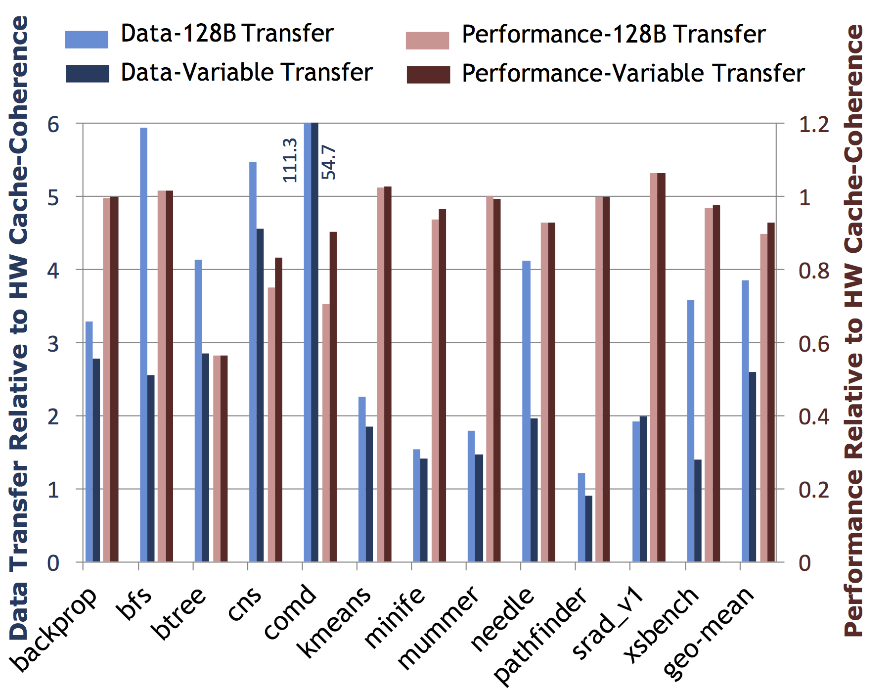
Variable Width Request Transfer
CPU caches all memory
GPU never caches CPU-memory
GPU caches GPU-memory if CPU not caching
v
Reduces DDR traffic from the GPU
CPUs
DDR4
Client Cache
DDR4
DDR4
Directory
DDR4
w
CPU/GPU reads DDR:
GPU caches until 1st write to the page
Improves CPU-GPU interconnect efficiency
Variable-size Transfer
CPU/GPU writes DDR:
Flush read-only pages in GPU caches
and updates page level protection
GDDR5
GDDR5
GDDR5
u
GDDR5
Remote Directory
GDDR5
Request Coalescer
GDDR5
GDDR5
Coalesces GPU requests to DDR
GDDR5
GPU

Slide 32
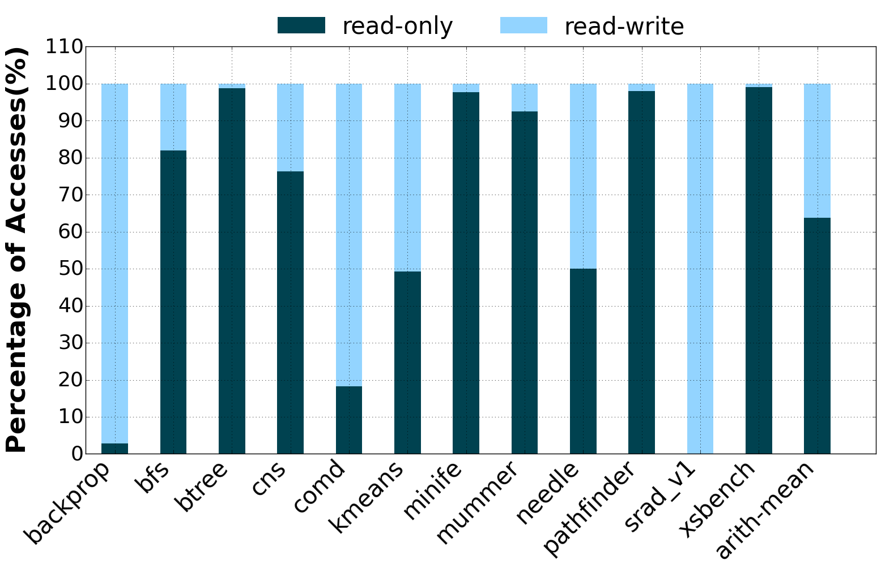
Lots of Read-only Data
62% data is read-only

Slide 33
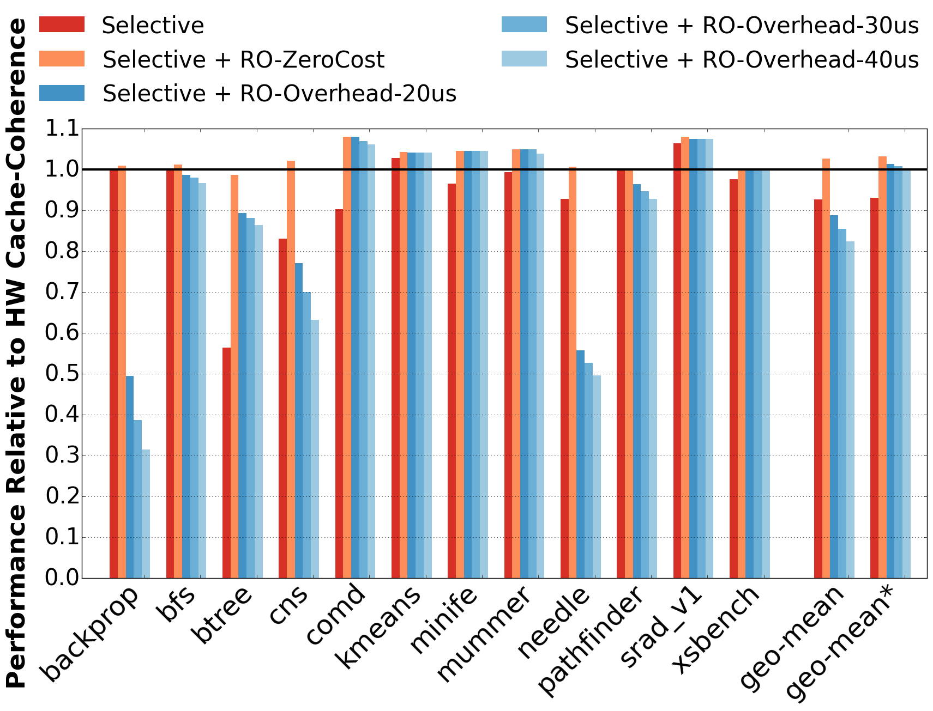
Request Coalescing
CPU caches all memory
GPU never caches CPU-memory
GPU caches GPU-memory if CPU not caching
v
Reduces DDR traffic from the GPU
CPUs
DDR4
Client Cache
DDR4
DDR4
Directory
DDR4
w
CPU/GPU reads DDR:
GPU caches until 1st write to the page
Improves CPU-GPU interconnect efficiency
Variable-size Transfer
CPU/GPU writes DDR:
Flush read-only pages in GPU caches
and updates page level protection
x
Provides safe caching
Read-only Cache
GDDR5
GDDR5
GDDR5
u
GDDR5
Remote Directory
GDDR5
Request Coalescer
GDDR5
GDDR5
Coalesces GPU requests to DDR
GDDR5
GPU

Slide 34
Selective Caching In A Nutshell
CPU caches all memory
GPU never caches CPU-memory
GPU caches GPU-memory if CPU not caching
v
Reduces DDR traffic from the GPU
CPUs
DDR4
Client Cache
DDR4
DDR4
Directory
DDR4
w
CPU/GPU reads DDR:
GPU caches until 1st write to the page
Improves CPU-GPU interconnect efficiency
Variable-size Transfer
CPU/GPU writes DDR:
Flush read-only pages in GPU caches
and updates page level protection
x
Provides safe caching
Read-only Cache
GDDR5
GDDR5
GDDR5
u
GDDR5
Remote Directory
GDDR5
Request Coalescer
GDDR5
GDDR5
Coalesces GPU requests to DDR
GDDR5
GPU
Micro-architectural enhancements: 93% of HW cache-coherence performance

Slide 35
Conclusion: CPU-GPU Systems
BW-AWARE placement maximizes GPU bandwidth utilization
Dynamic page migration: performance with programmability
Selective caching simplifies unified shared memory
Decouples vendor-specific coherence protocols

Slide 36
Proposal: Thermostat
Managing Huge Pages in Two-Tiered Memory in Data-centers

Slide 37

Data-center Memory TCO
^{30%}

Slide 38

New Memory Technology ½ DRAM Cost ~4x Slower than DRAM
Data-center Memory TCO
^{30%}

Slide 39

Reduce Data-center Memory TCO && Service Level Guarantees

Slide 40
What’s new with 2-Tier Memory?
Huge Pages

Slide 41
Huge Pages – Improve Performance
Regular OS pages: 4KB, Huge pages: 2MB
Advantages:
Fewer TLB misses
Faster TLB misses (3-level lookup instead of 4)
Performance gain of 10-15% with huge pages
Notes:
THP – Available today in Linux kernel

Slide 42
BUT

Slide 43
Problem: Huge Pages in 2-Tier Memory
Reduces fraction of cold data to be put into slow memory
Expensive to migrate data at 2MB granularity

Slide 44
Thermostat – Make Slow Memory Usable in Data-centers
Detect cold pages
Hot spots in otherwise cold huge pages
Multiple page mappings to fast and slow memory

Slide 45
Future Memory Hierarchy
CPU
100 ns
Hot Data
Fast Memory
(DRAM)
500 ns – 1us
Cold Data
Slow Memory
(3D X Point)

Slide 46
Cold Data Slow Memory
Identified cold data at runtime using “kstaled” in Linux kernel
~50% of cold 4KB pages can go to slow memory

Slide 47
Cold Data Slow Memory
Cold page fraction reduces from 50% to 15%

Slide 48
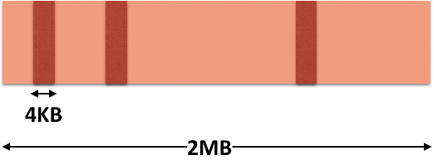
Problem: Identify HotSpots in Cold Huge Pages
Separate 4KB hot pages within 2MB huge page

Slide 49


Slide 50
Identifying HotSpot Huge Pages
Online sampling mechanism

Slide 51
Identifying HotSpot Huge Pages
Online sampling mechanism
HotSpot Huge Page
Cold Huge Page
Hot Huge Page

Slide 52
Future Memory Hierarchy
CPU
100 ns
Hot Huge Page + Hot 4KB
Fast Memory
(DRAM)
500 ns – 1us
500 ns – 1us
Cold + HotSpot Huge Pages
Slow Memory
(3D X Point)

Slide 53
Amount of cold data cdf

Slide 54
Multiple Memory Mappaings
Have 2 valid mappings for a page,
4KB mapping and 2MB mapping
Bit vector to validate 2MB mapping
...
If valid use 2MB mapping, else fetch 4KB mapping from memory

Slide 55
In Summary – Thermostat
Reaps benefits of huge pages while reducing memory cost in data-centers
Places cold pages in slow memory
Identifies HotSpots huge pages & puts their cold regions in slow memory
Translation facades keep hot 4KB pages in fast DRAM

